Slide 1
Ggplot2 and interactive graphics with R
Christophe Ladroue
SECTION 08
VIDEO 03
Making a bubble chart
with ggplot2
www.PacktPub.com

Slide 2
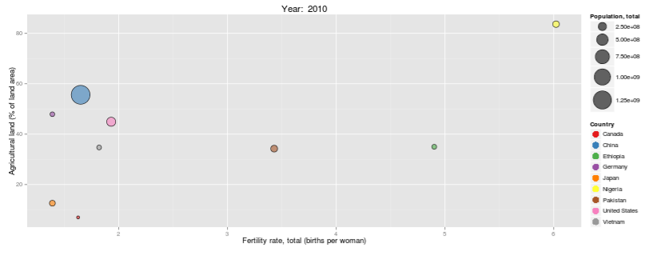
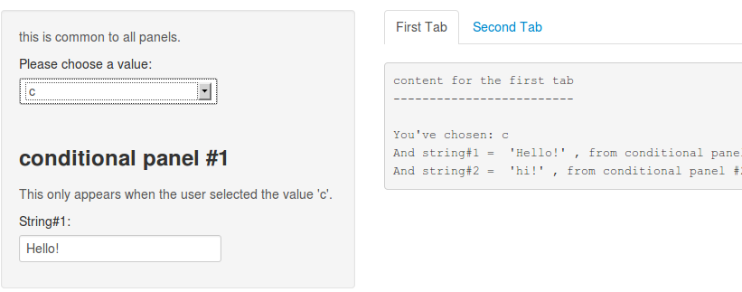
In this video we took a look at
how to build a bubble chart in ggplot2.
how to customize legends and axes’ title.
how to make an animation with a slider.
Next: making conditional panels

Slide 3
In this section we’re going to take a look at
Designing the dashboard
Building the time series plot
Making a bubble chart in ggplot2
Making conditional panels
Building our dashboard

